Slide 1
Peer Mock Interviews
TIP102
Week 6
Notes:
🌟 Purpose: Introduce the session and prepare students for peer mock interviews.
✅ What should I be doing?
Welcome students and set a collaborative tone for the session.
Emphasize the importance of mock interviews in building technical and communication skills.
🎙️ What should I be saying?
Welcome to Week 6, Session 2 of TIP102! Today, we’ll be conducting peer mock interviews. This is your opportunity to practice the skills you’ve been building in a real-world interview scenario.
Remember, the goal is to learn and improve—mistakes are part of the process, so don’t worry if things don’t go perfectly.
🙌🏽 How should I engage students?
Ask: "What’s one thing you’re looking forward to or hope to learn in today’s session?"

Slide 2
1 | Welcome 👋🏽 | 0:00 - 0:10
2 | Peer Mock Interviews | 0:10 - 0:25
3 | BREAK | 0:45 - 0:50
4 | Collaborative Problem Solving | 0:50 - 1:50
5 | Wrap Up | 1:50 - 2:00
Notes:
🌟 Purpose: Outline the session's structure and set expectations.
✅ What should I be doing?
Walk students through the schedule and ensure clarity about the activities.
🎙️ What should I be saying?
Here’s what we’ll cover today: We’ll start with peer mock interviews, take a short break, and then dive into collaborative problem-solving. We’ll wrap up with reflections and next steps.
The focus today is on applying the UMPIRE strategy and improving interview techniques.
🙌🏽 How should I engage students?
Pause to ask if anyone has questions or needs clarification about the schedule.

Slide 3
Welcome! 👋🏽
10 minutes

Slide 4


Turn on your cameras
Fill out the entry ticket
Notes:
🌟 Purpose: Encourage visual engagement to foster connection during the session.
✅ What should I be doing?
Prompt students to enable their cameras and submit the entry ticket.
🎙️ What should I be saying?
Let’s kick off our session by turning on our cameras!
Also, don’t forget to fill out the entry ticket to help us organize breakout rooms later.
🙌🏽 How should I engage students?
Use humor or compliments: "Let’s see those smiles!"
Acknowledge and thank students who turn on their cameras.

Slide 5
5 minutes
UPDATE ME!
Add a fun and engaging icebreaker to help build community and get students ready for the day.
DELETE THIS BOX WHEN YOU’RE DONE!

Slide 6
UPDATE ME!
Review the feedback from the previous Session Survey and note key themes here to share with the class.
DELETE THIS BOX WHEN YOU’RE DONE!
+
-
Notes:
🌟 Purpose: Share feedback from the previous session and highlight areas of success and improvement.
✅ What should I be doing?
Summarize feedback from the previous session's survey and present key takeaways.
🎙️ What should I be saying?
From your feedback, it seems many of you enjoyed [highlighted aspect]. One suggestion was [area for improvement]. We’ll work on that today.
🙌🏽 How should I engage students?
Ask: "Does anyone have additional feedback or suggestions?"

Slide 7

Announcements & Reminders
UPDATE ME!
Add any announcements or reminders. These will often come from the SSL or Liz, so be sure to check in with them to see if there are any that need to be added here if that information hasn’t been shared with you already.
DELETE THIS BOX WHEN YOU’RE DONE!

Slide 8
Peer Mock Interviews
35 minutes

Slide 9
Today's Mock Interviews
One student will act as the interviewer.
Guides the process by asking questions, clarifying requirements, and prompting the interviewee to think about edge cases or optimization.
Observes and takes notes for feedback but does not solve the problem.
The other student will act as the interviewee.
Solves the problem while thinking aloud and applying the UMPIRE steps.
Communicates their thought process clearly to the interviewer.
Notes:
🌟 Purpose: Explain the roles and expectations for peer mock interviews.
✅ What should I be doing?
Clearly define the interviewer and interviewee roles.
🎙️ What should I be saying?
Here’s how the mock interviews will work: One student will act as the interviewer, guiding the process by asking questions, clarifying requirements, and prompting the interviewee to think about edge cases or optimizations.
The other student will act as the interviewee, solving the problem while thinking aloud and applying the UMPIRE steps. The key here is clear communication—you should explain your thought process as you go.
You’ll stay in your assigned role for the duration of the interview.
🙌🏽 How should I engage students?
Ask: "Does everyone feel comfortable with their roles? What questions do you have about how this process works?"

Slide 10
Today's Mock Interviews
How much time does each person get?
Each partner will get 15 minutes. After the first 15 min, switch roles and problem
When 3 min are left in each turn, stop mock interview and share feedback with partner!
What should I get done in 12 minutes?
Try to at least get thru the “U” and “P” step!
Where can I find the problems?
In the deck!
Problem 1
Problem 2
Notes:
🌟 Purpose: Explain the roles and expectations for peer mock interviews.
✅ What should I be doing?
Clearly define the interviewer and interviewee roles.
🎙️ What should I be saying?
Here’s how the mock interviews will work: One student will act as the interviewer, guiding the process by asking questions, clarifying requirements, and prompting the interviewee to think about edge cases or optimizations.
The other student will act as the interviewee, solving the problem while thinking aloud and applying the UMPIRE steps. The key here is clear communication—you should explain your thought process as you go.
You’ll stay in your assigned role for the duration of the interview.
🙌🏽 How should I engage students?
Ask: "Does everyone feel comfortable with their roles? What questions do you have about how this process works?"

Slide 11
Peer Feedback
When there's ~5 minutes left, the interviewer should provide feedback:
One strength
One area for improvement
Notes:
🌟 Purpose: Highlight the importance of constructive feedback after the mock interview.
✅ What should I be doing?
Explain the structure and goals of the feedback session.
🎙️ What should I be saying?
At the end of the mock interview, the interviewer will provide feedback. Focus on one strength and one area for improvement.
This feedback is meant to help your peer grow and identify areas they can work on. Be specific and constructive.
For example, you might say, 'You did a great job explaining your thought process, but you could work on handling edge cases more thoroughly.
🙌🏽 How should I engage students?
Encourage thoughtfulness: "What’s one thing you’d appreciate hearing from a peer about your own performance?"

Slide 12
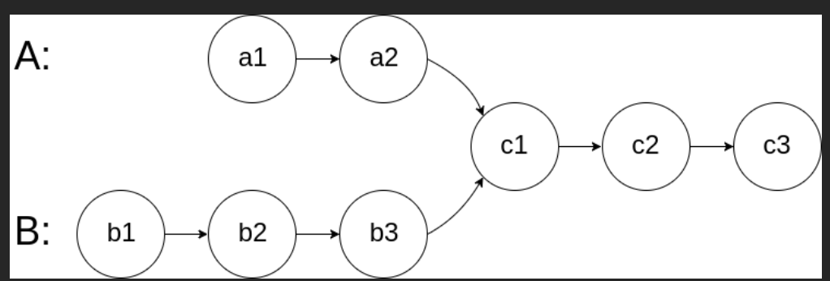
15 minutes
Write a function to find the intersection of 2 singly linked lists. Return the node at which the linked lists intersect. If the 2 lists have no intersection, return None.
For example, in the below screenshot from Leetcode, the 2 lists intersect at c1 so your function should return a reference to c1.
https://leetcode.com/problems/intersection-of-two-linked-lists/description/

Slide 13
15 minutes
You are given two non-empty linked lists representing two non-negative integers. The digits are stored in reverse order, and each of their nodes contains a single digit. Add the two numbers and return the sum as a linked list.
✨Check out the problem in Leetcode for illustrations and details! ✨

Slide 14
3 minutes
In the chat . . .
How did we do? What did we do well? What are things we need to work on to improve?
Notes:
🌟 Purpose: Reflect on the mock interviews and gather feedback on the process.
✅ What should I be doing?
Facilitate a discussion to help students consolidate their learnings from the interviews.
🎙️ What should I be saying?
Let’s take a moment to reflect. In the chat, share one thing that went well during the mock interviews and one thing we can work on to improve.
This is a chance to celebrate your wins and identify specific ways to grow as interviewers and interviewees.
🙌🏽 How should I engage students?
Read a few responses aloud, emphasizing actionable insights. Encourage follow-up: "Why do you think that approach worked well?" or "What’s one way you’d implement that feedback in your next interview?"

Slide 15
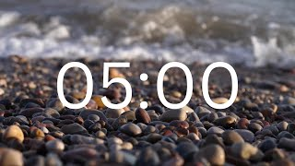
Break Time!
Take 5 mins to step away from the computer. Feel free to turn off your camera and return promptly after 5 mins.
Notes:
🌟 Purpose: Provide a short break to refresh and re-energize.
✅ What should I be doing?
Announce the break and remind students to return on time.
Play the countdown timer video (be sure to share sound).
🎙️ What should I be saying?
Let’s take 5 minutes to step away from the screen. Be sure to return promptly.

Slide 16
Collaborative Problem Solving
60 minutes

Slide 17
60 minutes
🏃🏽 Navigate to your breakout room.
👋🏽 Introduce yourselves!
🧑🏽‍💻 Work on the problems for your selected unit.

Slide 18
Wrap Up
10 minutes

Slide 19
Notes:
🌟 Purpose: End the session on a positive note.
✅ What should I be doing?
Prompt students to share their reflections in the chat.
🎙️ What should I be saying?
Let’s celebrate your wins. Share one good thing you learned or accomplished today!
🙌🏽 How should I engage students?
Read a few responses aloud and celebrate with enthusiasm.

Slide 20

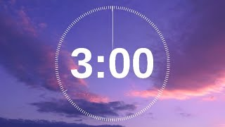
Session Survey Time!
Notes:
🌟 Purpose: Gather feedback to improve future sessions.
✅ What should I be doing?
Share the survey link and emphasize its importance.
🎙️ What should I be saying?
Your feedback helps us make these sessions even better. Please take a moment to complete the survey.
🙌🏽 How should I engage students?
Thank students for their input and explain how feedback has been used in the past.

Slide 21

Final Reminders
Finish the problem sets for additional practice
Take the weekly HackerRank assessment by Sunday @ midnight
UPDATE ME!
Add any parting reminders. These might be to emphasize announcements and reminders from the beginning of the session, or additional ones that were saved for the end.
DELETE THIS BOX WHEN YOU’RE DONE!
Notes:
🌟 Purpose: Provide a short break to refresh and re-energize.
✅ What should I be doing?
Announce the break and remind students to return on time.
Play the countdown timer video (be sure to share sound).
🎙️ What should I be saying?
Let’s take 5 minutes to step away from the screen. Be sure to return promptly.

